Slide 1


Results Overview
X
Biochemical Engineering Lab & Janssen Cilag AG
Eduard Meier
Master Thesis Student
18.07.23

Slide 2
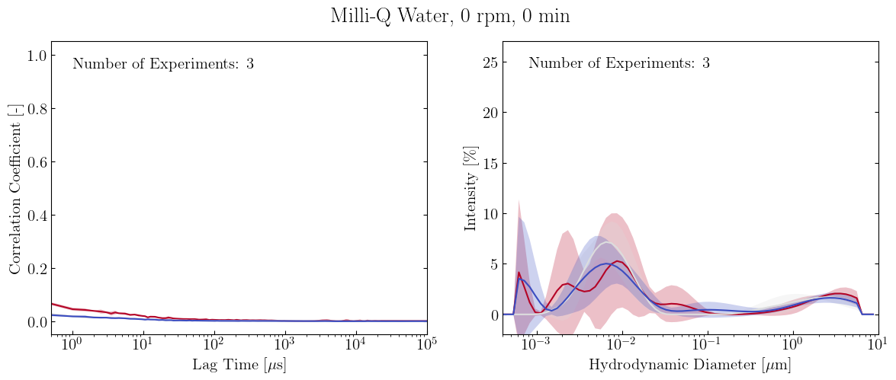
All Plots
Individual Plots

Slide 3
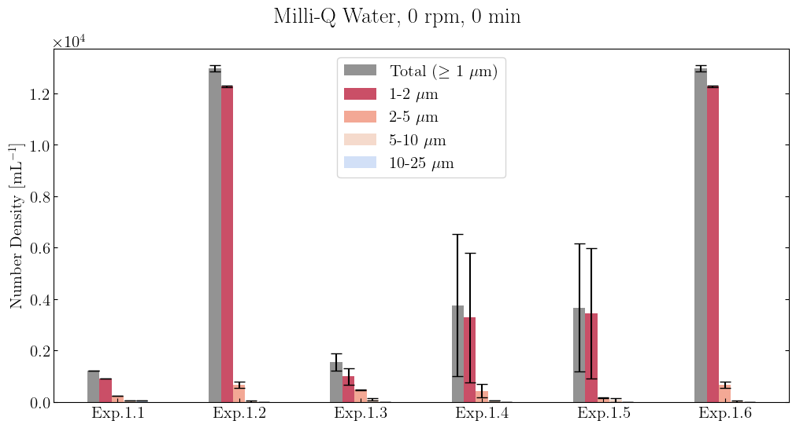
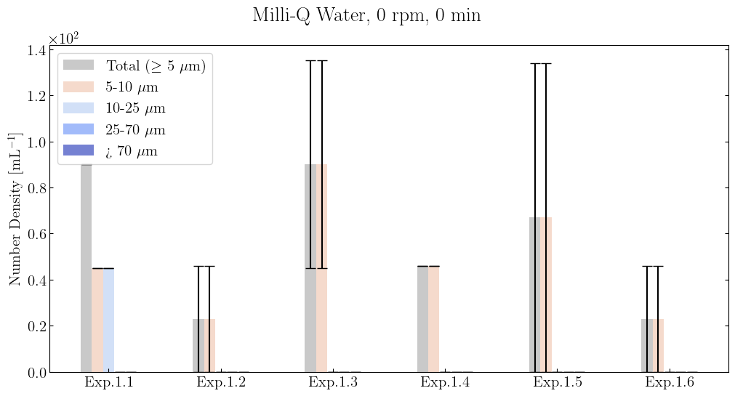
All Plots
Individual Plots

Slide 4
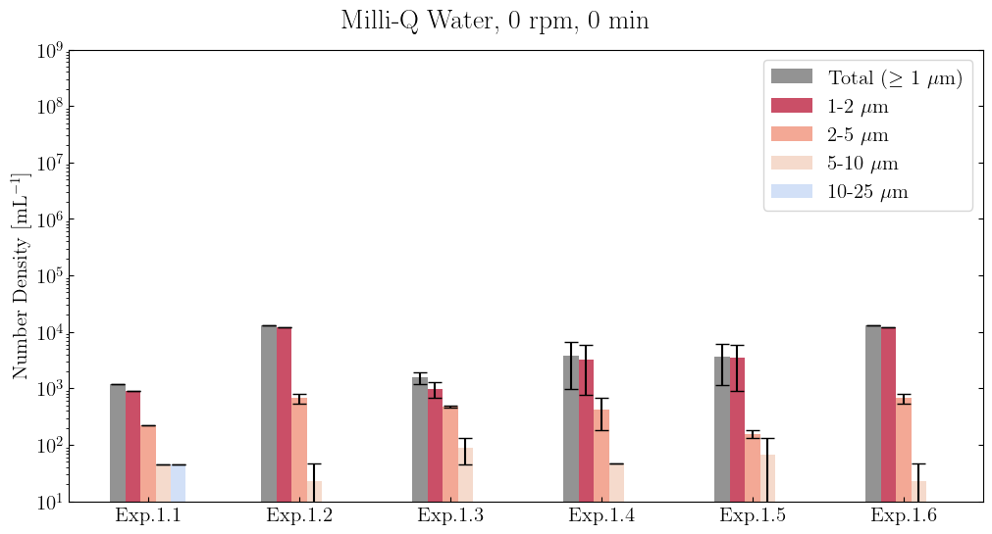
All Plots
Individual Plots

Slide 5
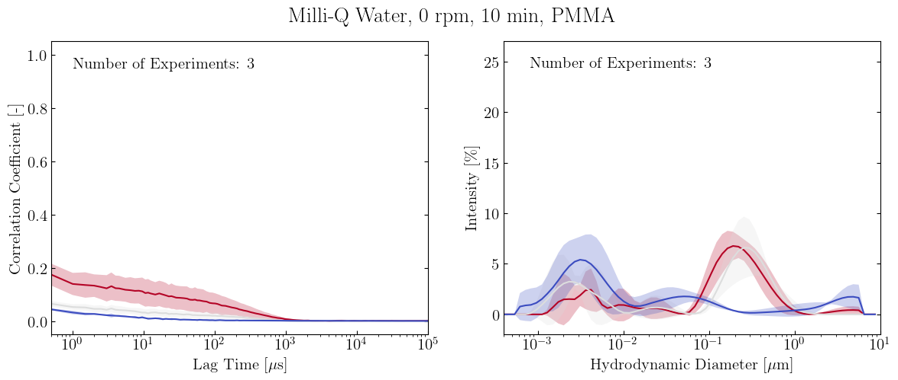
All Plots
Individual Plots

Slide 6
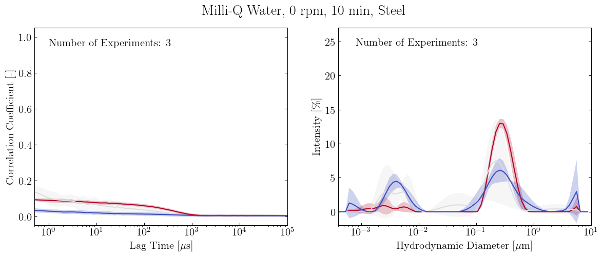
All Plots
Individual Plots

Slide 7
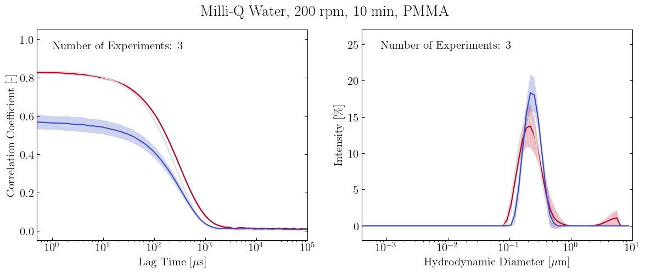
All Plots
Individual Plots

Slide 8
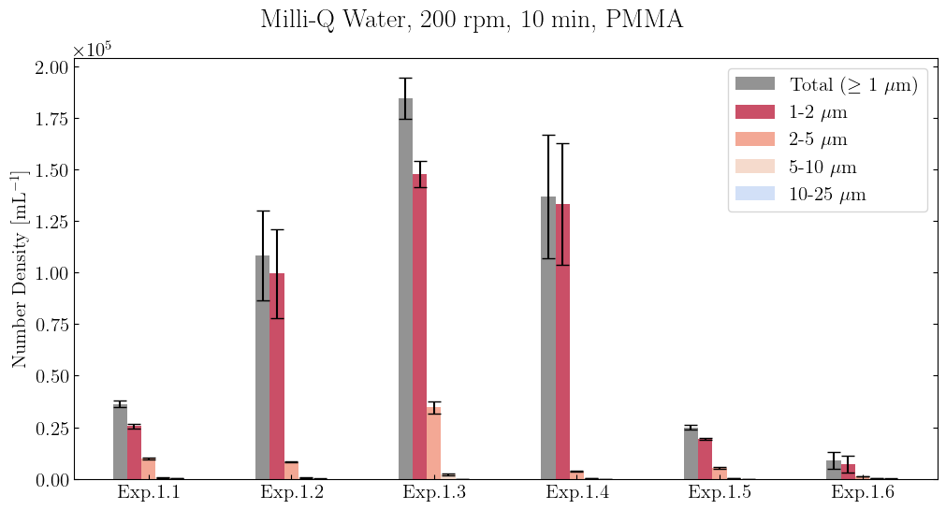
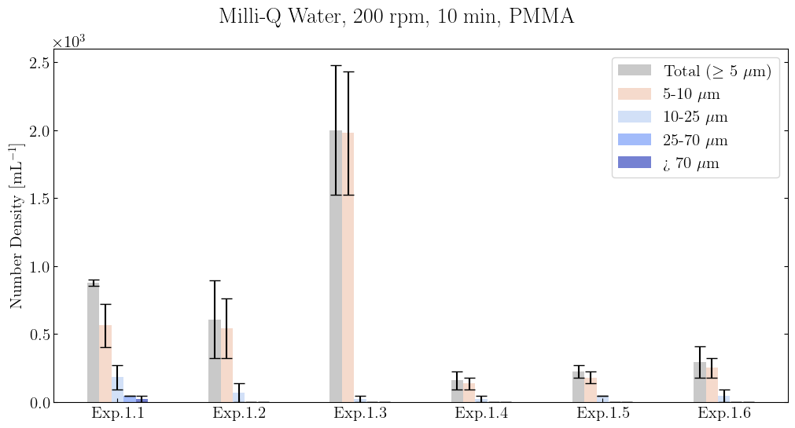
All Plots
Individual Plots

Slide 9
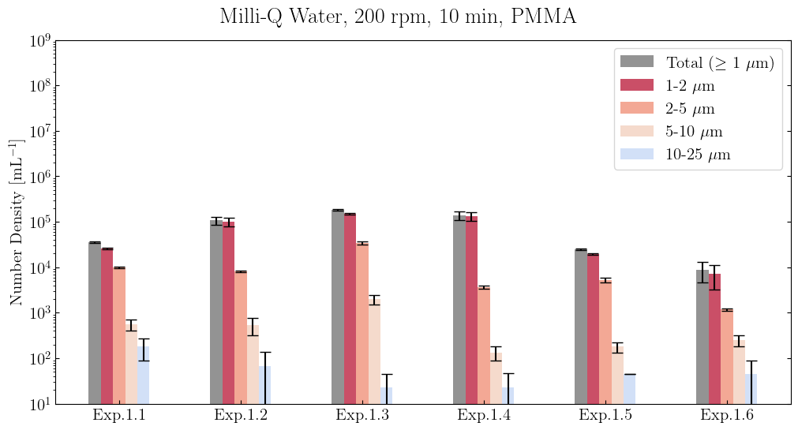
All Plots
Individual Plots

Slide 10
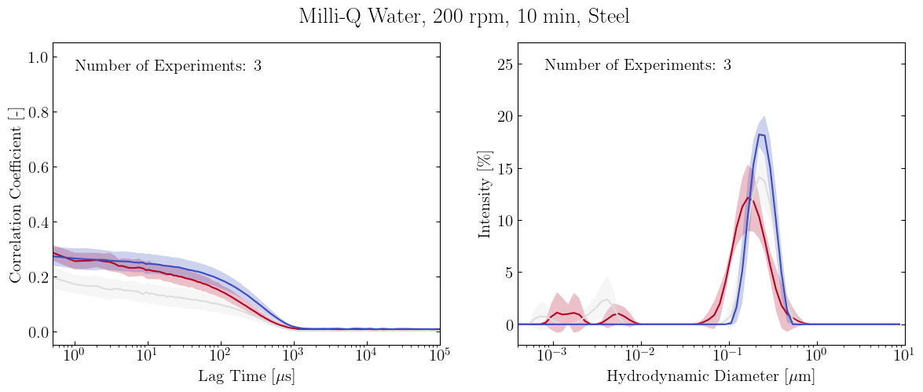
All Plots
Individual Plots

Slide 11
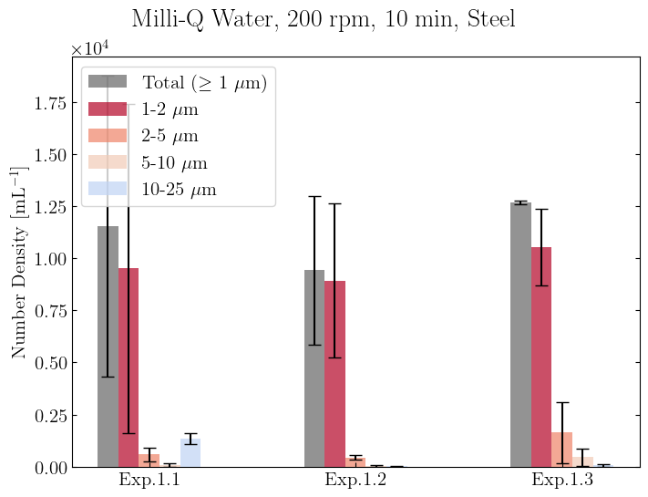
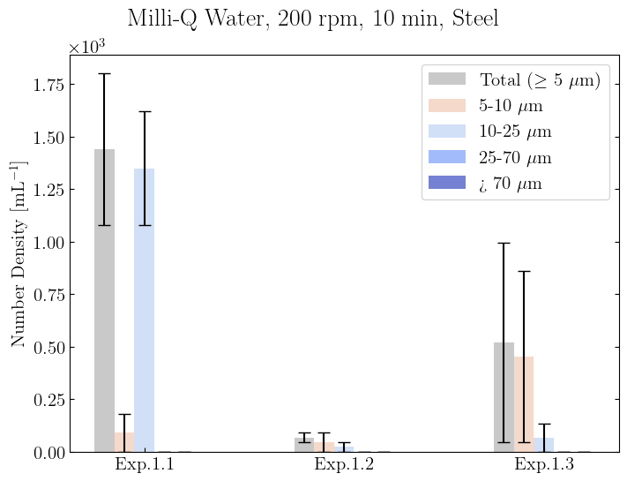
All Plots
Individual Plots

Slide 12
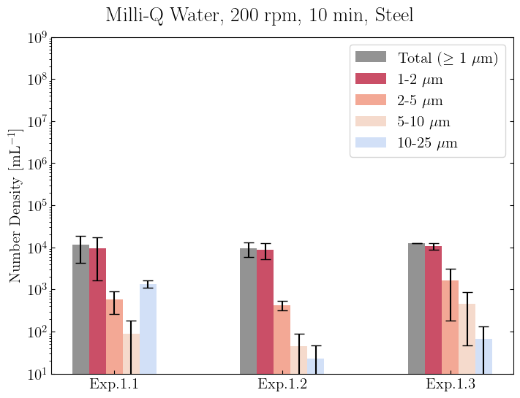
All Plots
Individual Plots

Slide 13
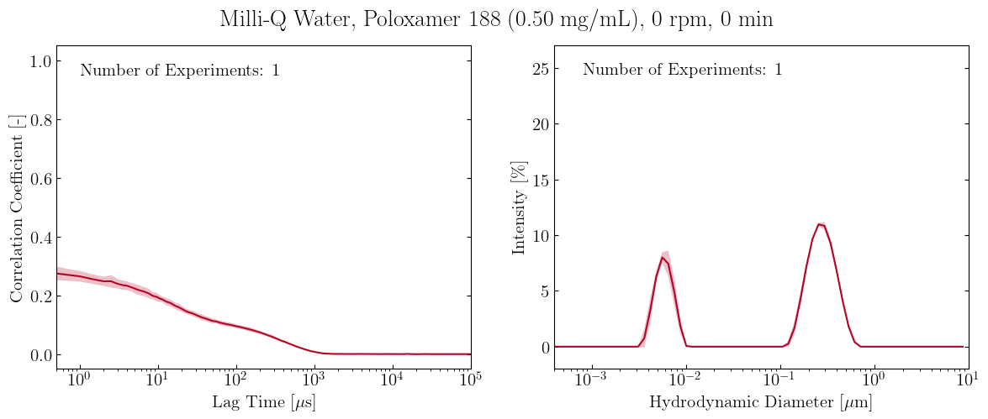
All Plots
Individual Plots

Slide 14
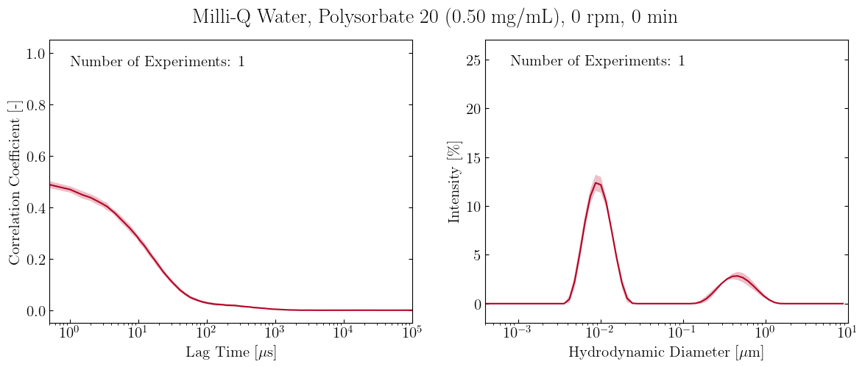
All Plots
Individual Plots

Slide 15
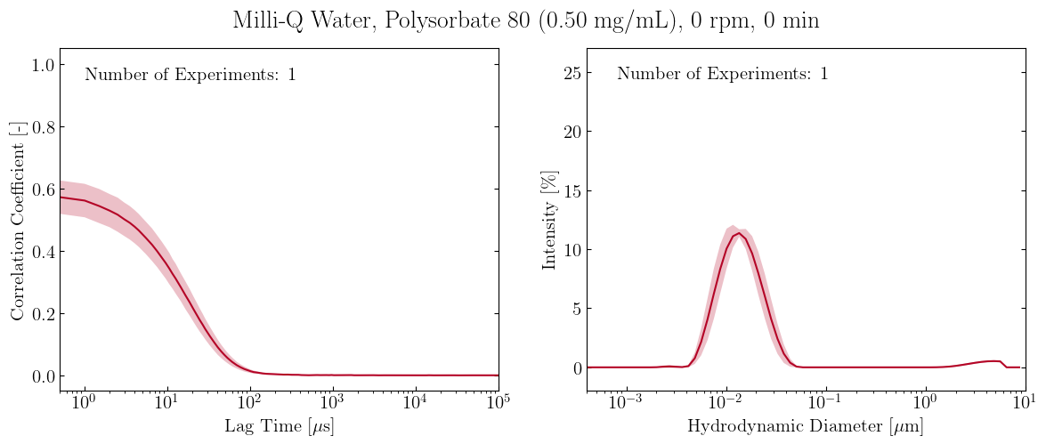
All Plots
Individual Plots

Slide 16
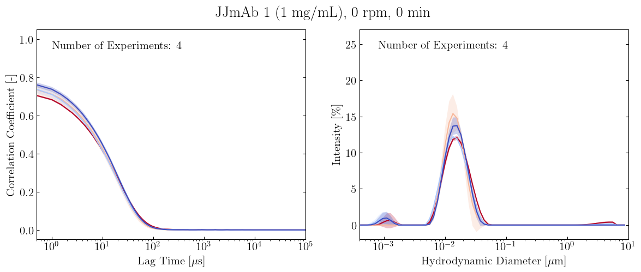
All Plots
Individual Plots

Slide 17
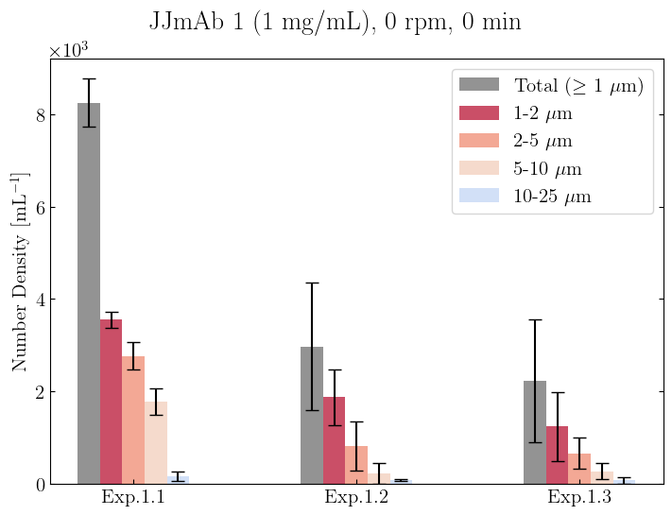
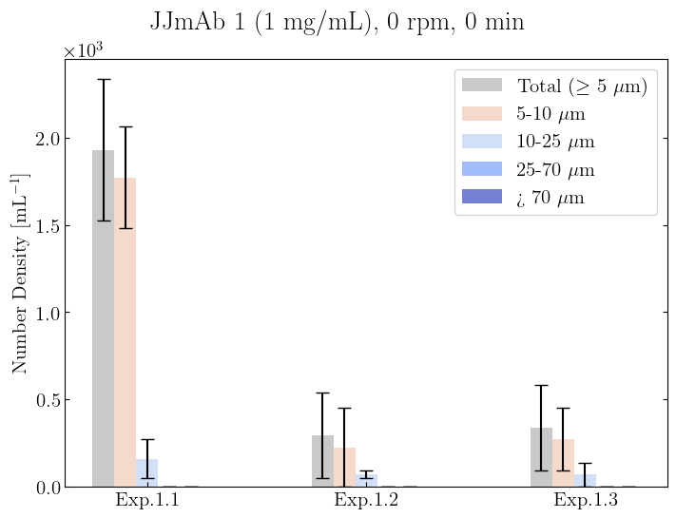
All Plots
Individual Plots

Slide 18
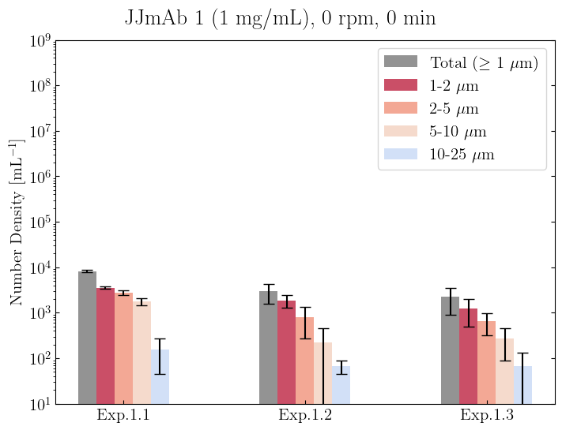
All Plots
Individual Plots

Slide 19
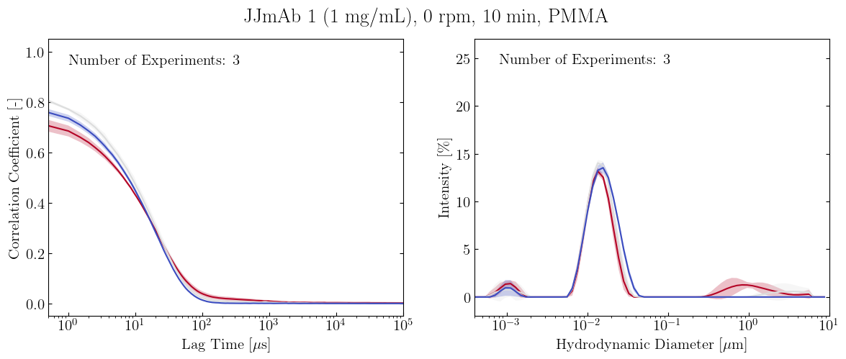
All Plots
Individual Plots

Slide 20
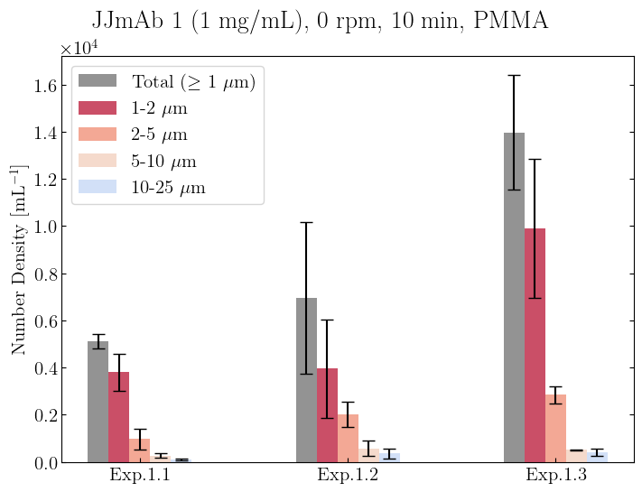
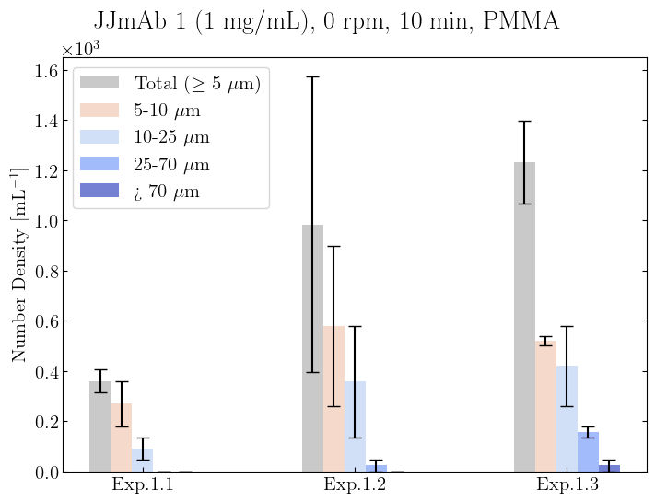
All Plots
Individual Plots

Slide 21
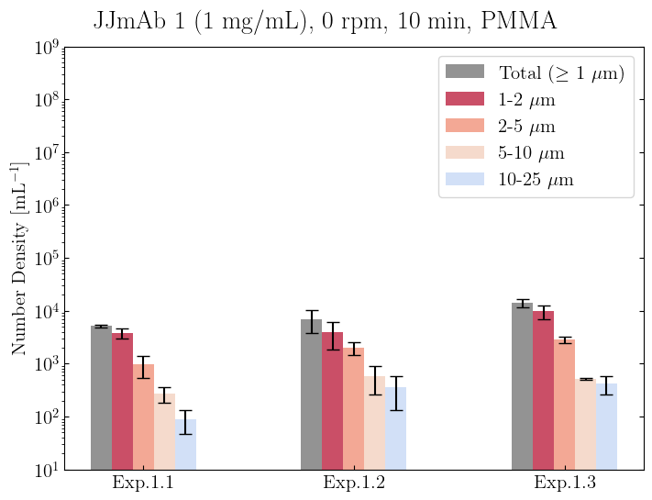
All Plots
Individual Plots

Slide 22
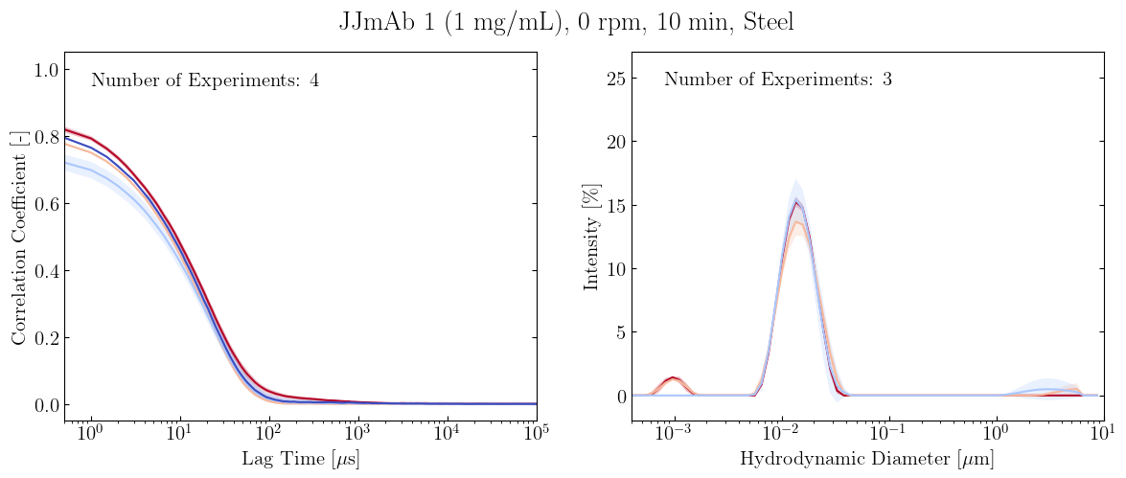
All Plots
Individual Plots

Slide 23
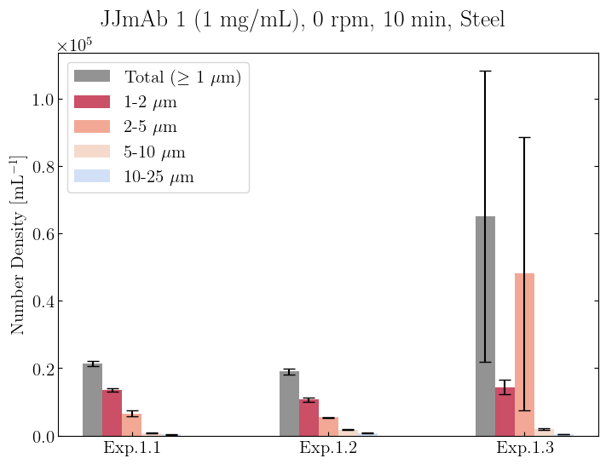
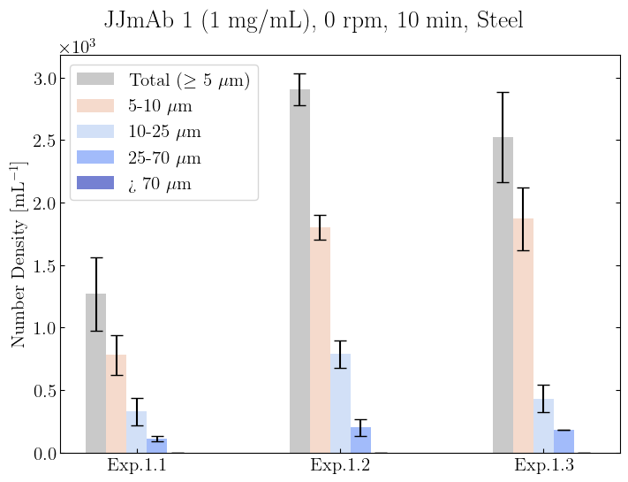
All Plots
Individual Plots

Slide 24
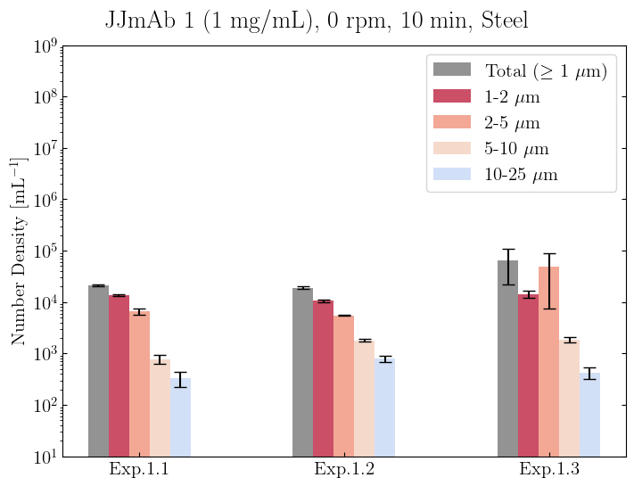
All Plots
Individual Plots

Slide 25
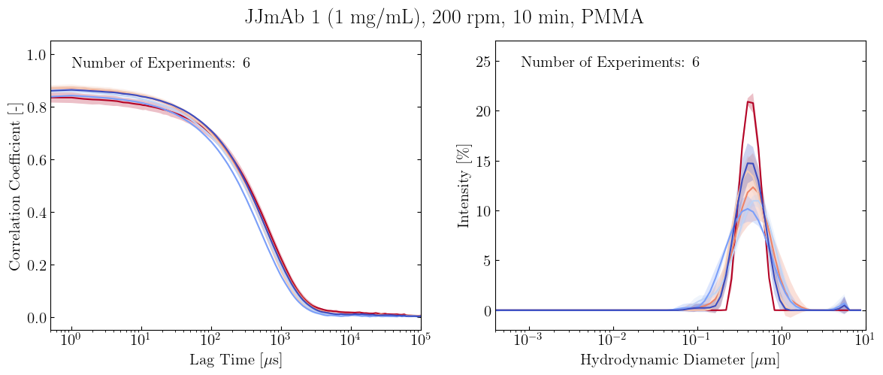
All Plots
Individual Plots

Slide 26
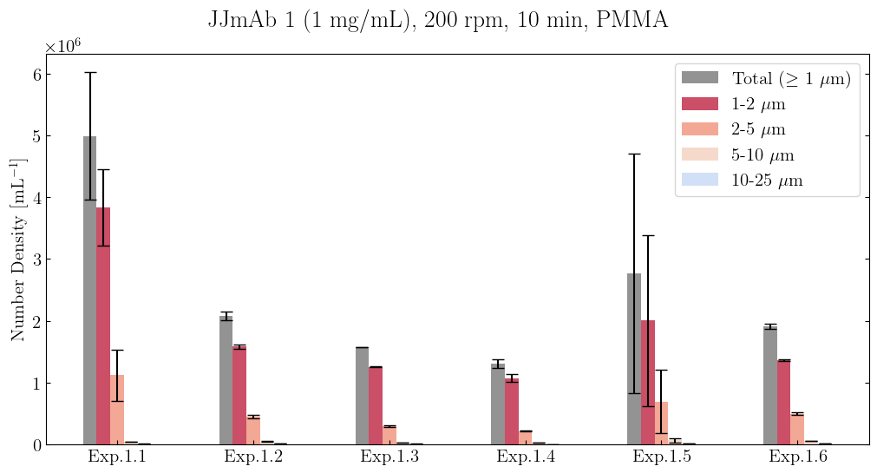
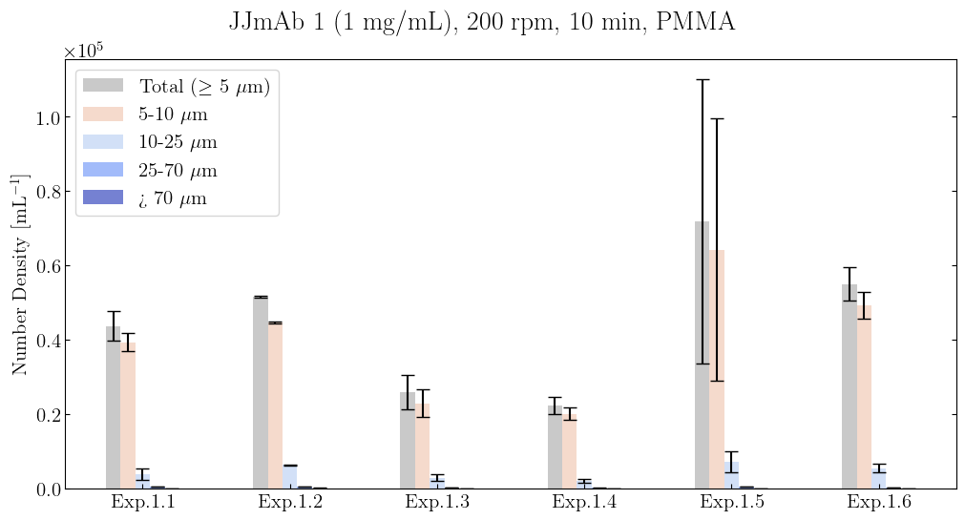
All Plots
Individual Plots

Slide 27
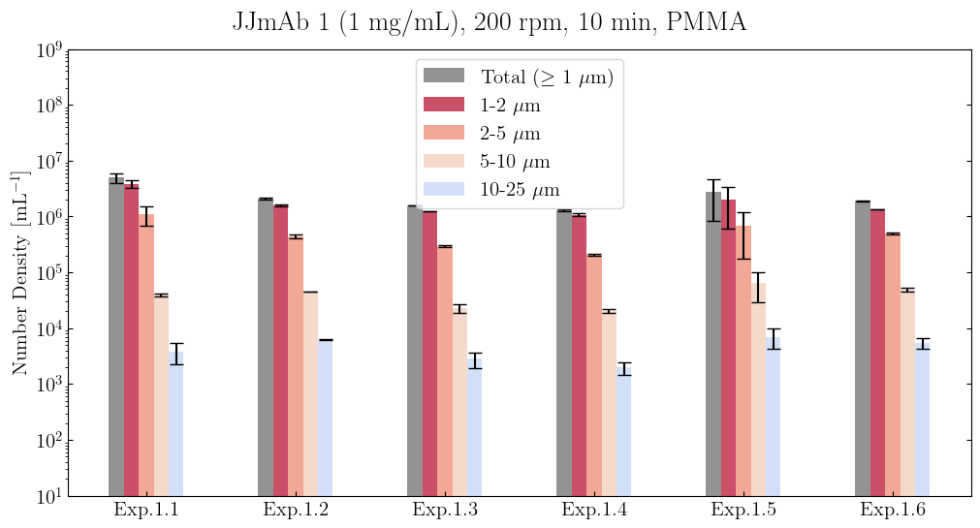
All Plots
Individual Plots

Slide 28
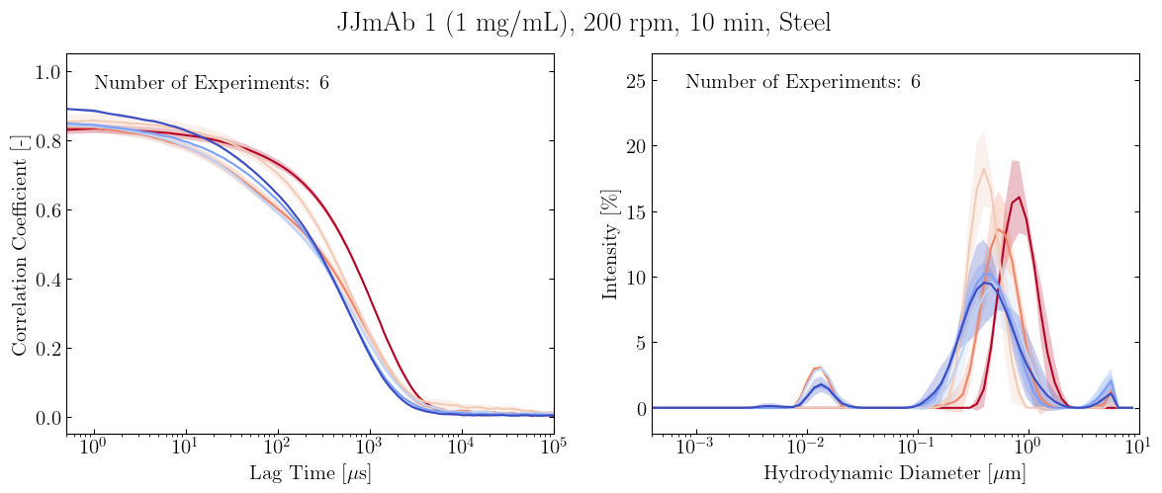
All Plots
Individual Plots

Slide 29
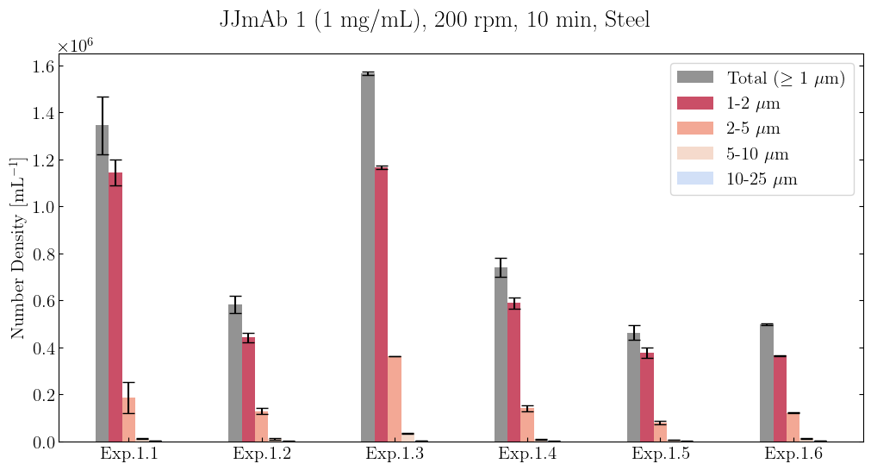
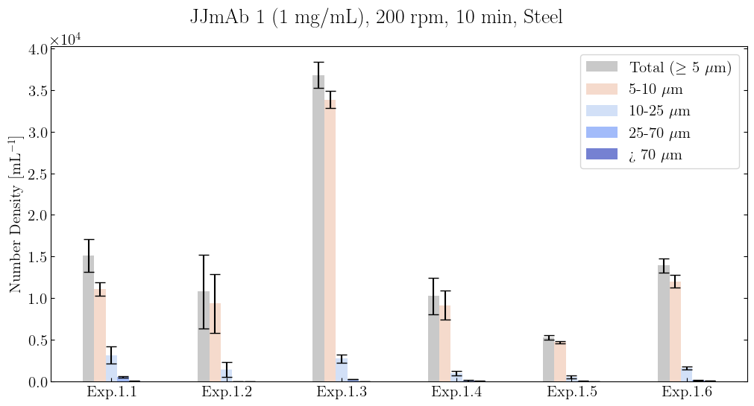
All Plots
Individual Plots

Slide 30
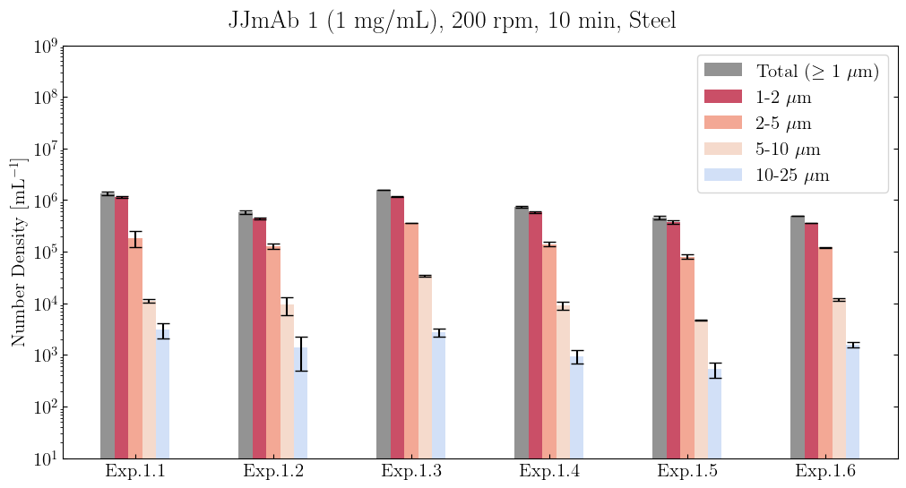
All Plots
Individual Plots

Slide 31
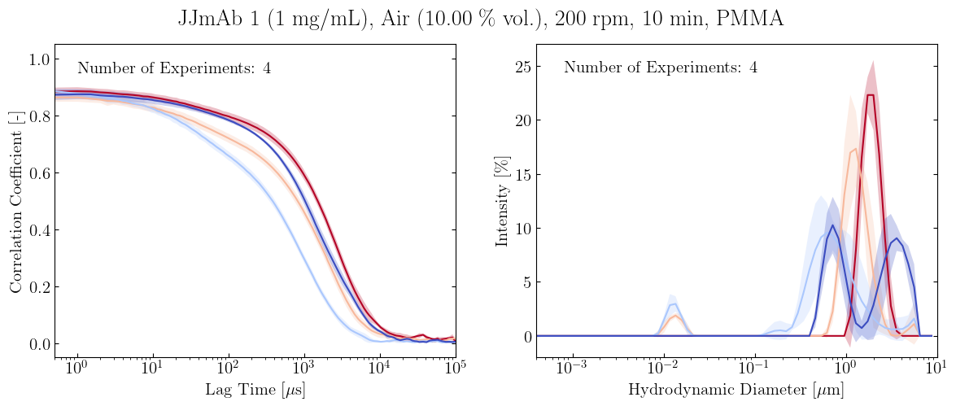
All Plots
Individual Plots

Slide 32
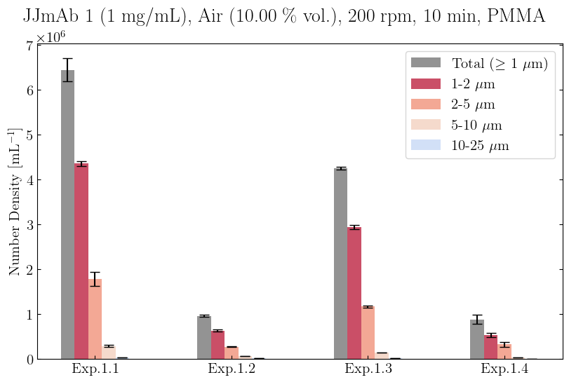
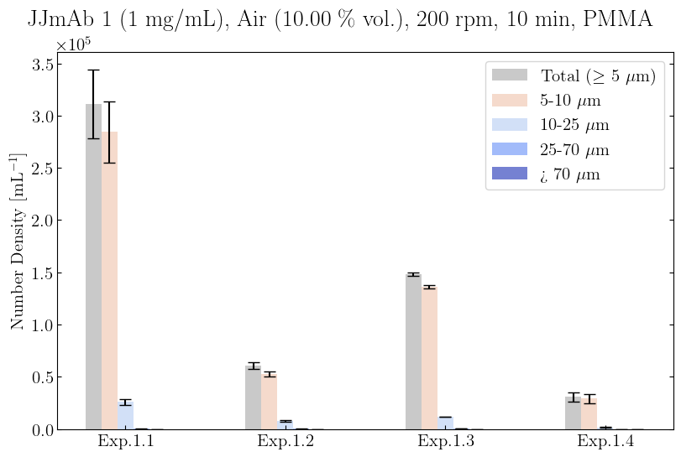
All Plots
Individual Plots

Slide 33
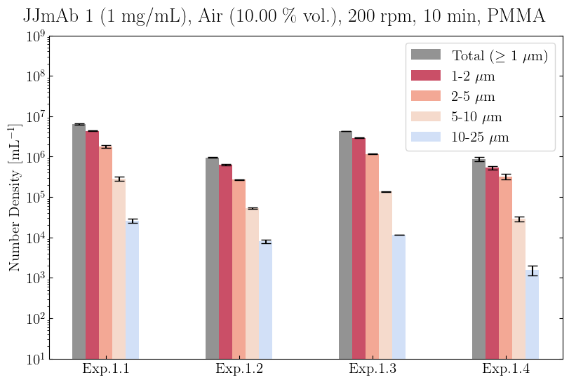
All Plots
Individual Plots

Slide 34
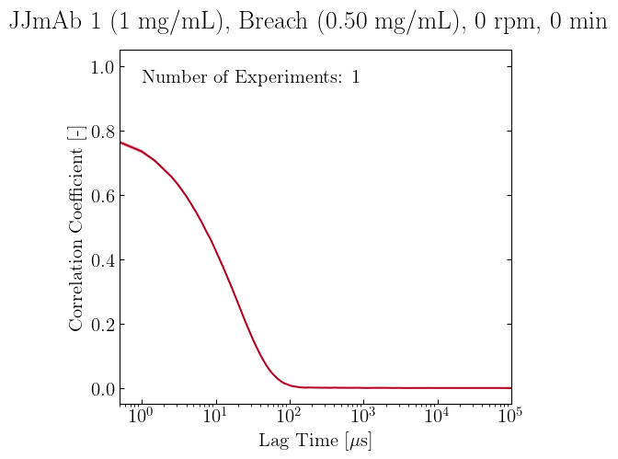
All Plots
Individual Plots

Slide 35
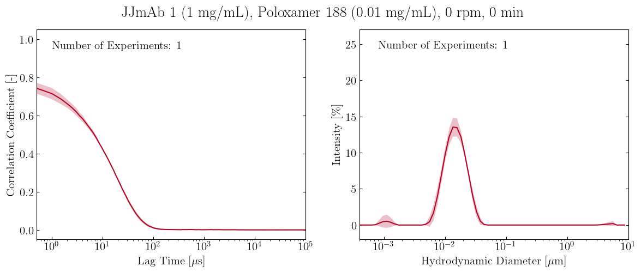
All Plots
Individual Plots

Slide 36
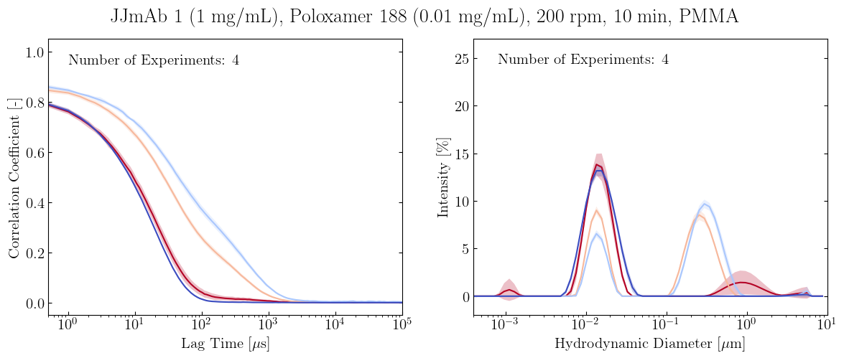
All Plots
Individual Plots

Slide 37
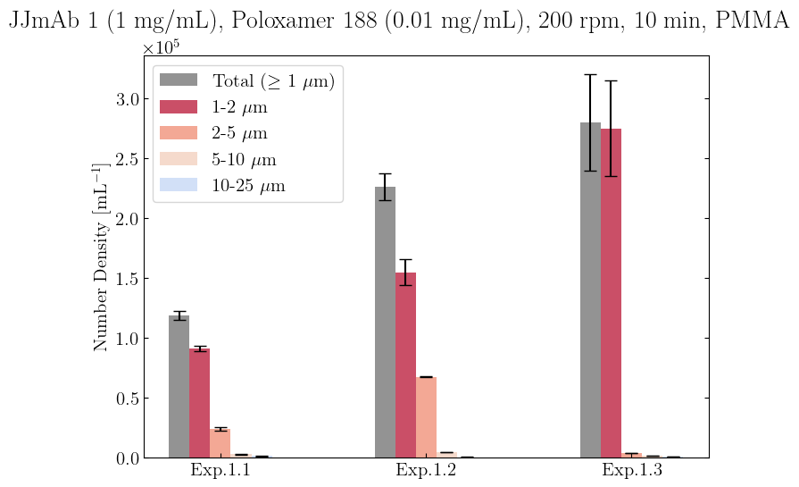
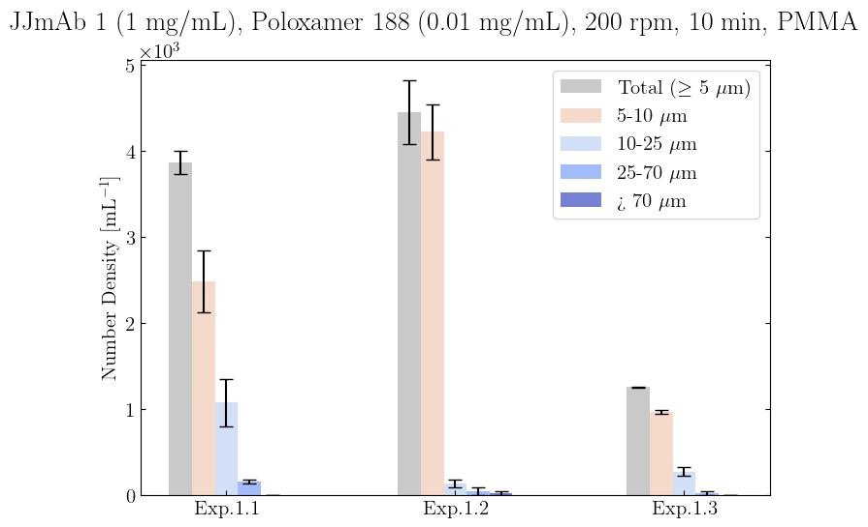
All Plots
Individual Plots

Slide 38
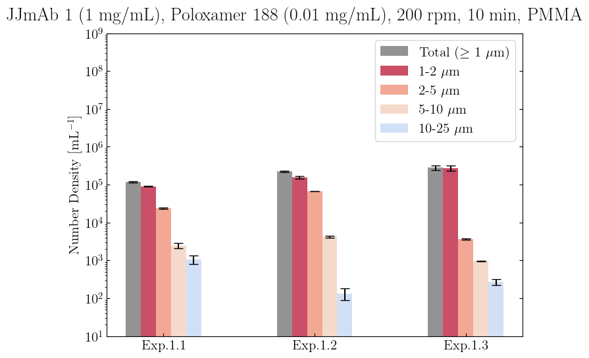
All Plots
Individual Plots

Slide 39
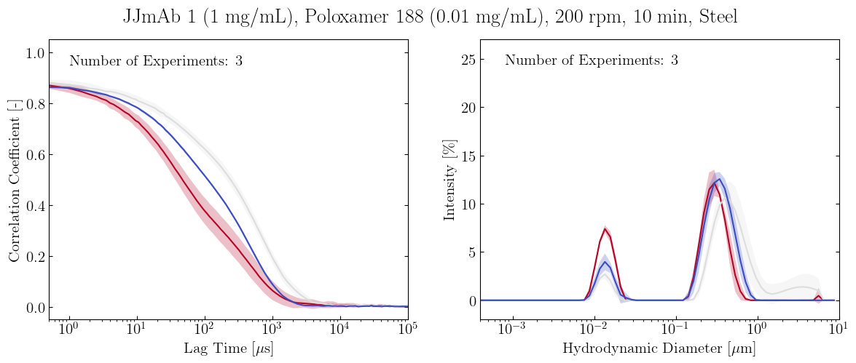
All Plots
Individual Plots

Slide 40
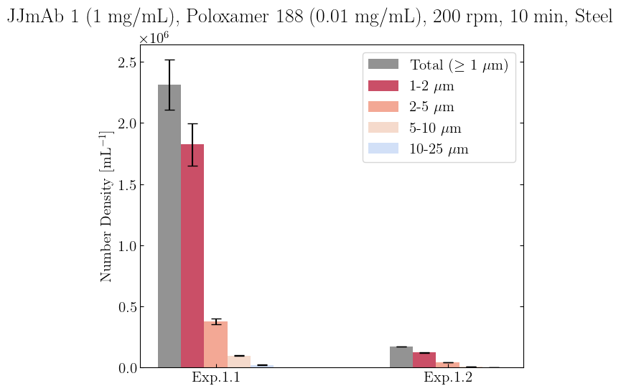
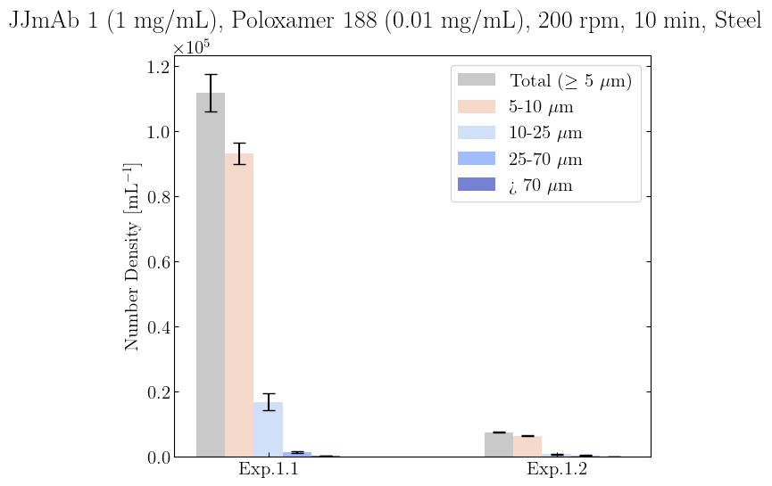
All Plots
Individual Plots

Slide 41

All Plots
Individual Plots

Slide 42

All Plots
Individual Plots

Slide 43

All Plots
Individual Plots

Slide 44


All Plots
Individual Plots

Slide 45

All Plots
Individual Plots

Slide 46

All Plots
Individual Plots

Slide 47


All Plots
Individual Plots

Slide 48

All Plots
Individual Plots

Slide 49

All Plots
Individual Plots

Slide 50

All Plots
Individual Plots

Slide 51


All Plots
Individual Plots

Slide 52

All Plots
Individual Plots

Slide 53

All Plots
Individual Plots

Slide 54


All Plots
Individual Plots

Slide 55

All Plots
Individual Plots

Slide 56

All Plots
Individual Plots

Slide 57


All Plots
Individual Plots

Slide 58

All Plots
Individual Plots

Slide 59

All Plots
Individual Plots

Slide 60


All Plots
Individual Plots

Slide 61

All Plots
Individual Plots

Slide 62

All Plots
Individual Plots

Slide 63


All Plots
Individual Plots

Slide 64

All Plots
Individual Plots

Slide 65

All Plots
Individual Plots

Slide 66


All Plots
Individual Plots

Slide 67

All Plots
Individual Plots

Slide 68

All Plots
Individual Plots

Slide 69


All Plots
Individual Plots

Slide 70

All Plots
Individual Plots

Slide 71

All Plots
Individual Plots

Slide 72

All Plots
Individual Plots

Slide 73


All Plots
Individual Plots

Slide 74

All Plots
Individual Plots

Slide 75

All Plots
Individual Plots

Slide 76


All Plots
Individual Plots

Slide 77

All Plots
Individual Plots

Slide 78

All Plots
Individual Plots

Slide 79

All Plots
Individual Plots

Slide 80


All Plots
Individual Plots

Slide 81

All Plots
Individual Plots

Slide 82

All Plots
Individual Plots

Slide 83


All Plots
Individual Plots

Slide 84

All Plots
Individual Plots

Slide 85

All Plots
Individual Plots

Slide 86

All Plots
Individual Plots

Slide 87


All Plots
Individual Plots

Slide 88

All Plots
Individual Plots

Slide 89

All Plots
Individual Plots

Slide 90


All Plots
Individual Plots

Slide 91

All Plots
Individual Plots

Slide 92

All Plots
Individual Plots

Slide 93


All Plots
Individual Plots

Slide 94

All Plots
Individual Plots

Slide 95

All Plots
Individual Plots

Slide 96


All Plots
Individual Plots

Slide 97

All Plots
Individual Plots

Slide 98

All Plots
Individual Plots

Slide 99


All Plots
Individual Plots

Slide 100

All Plots
Individual Plots

Slide 101

All Plots
Individual Plots

Slide 102


All Plots
Individual Plots

Slide 103

All Plots
Individual Plots

Slide 104

All Plots
Individual Plots

Slide 105


All Plots
Individual Plots

Slide 106

All Plots
Individual Plots

Slide 107

All Plots
Individual Plots

Slide 108

All Plots
Individual Plots

Slide 109


All Plots
Individual Plots

Slide 110

All Plots
Individual Plots

Slide 111

All Plots
Individual Plots

Slide 112


All Plots
Individual Plots

Slide 113

All Plots
Individual Plots

Slide 114

All Plots
Individual Plots

Slide 115

All Plots
Individual Plots

Slide 116


All Plots
Individual Plots

Slide 117

All Plots
Individual Plots

Slide 118

All Plots
Individual Plots

Slide 119


All Plots
Individual Plots

Slide 120

All Plots
Individual Plots

Slide 121

All Plots
Individual Plots

Slide 122

All Plots
Individual Plots

Slide 123


All Plots
Individual Plots

Slide 124

All Plots
Individual Plots

Slide 125

All Plots
Individual Plots

Slide 126


All Plots
Individual Plots

Slide 127

All Plots
Individual Plots

Slide 128

All Plots
Individual Plots

Slide 129


All Plots
Individual Plots

Slide 130

All Plots
Individual Plots

Slide 131

All Plots
Individual Plots

Slide 132


All Plots
Individual Plots

Slide 133

All Plots
Individual Plots

Slide 134

All Plots
Individual Plots

Slide 135


All Plots
Individual Plots

Slide 136

All Plots
Individual Plots

Slide 137

All Plots
Individual Plots

Slide 138


All Plots
Individual Plots

Slide 139

All Plots
Individual Plots

Slide 140

All Plots
Individual Plots

Slide 141


All Plots
Individual Plots

Slide 142

All Plots
Individual Plots

Slide 143

All Plots
Individual Plots

Slide 144

All Plots
Individual Plots

Slide 145

All Plots
Individual Plots

Slide 146


All Plots
Individual Plots

Slide 147

All Plots
Individual Plots

Slide 148

All Plots
Individual Plots

Slide 149


All Plots
Individual Plots

Slide 150

All Plots
Individual Plots

Slide 151

All Plots
Individual Plots

Slide 152


All Plots
Individual Plots

Slide 153

All Plots
Individual Plots

Slide 154

All Plots
Individual Plots

Slide 155


All Plots
Individual Plots

Slide 156

All Plots
Individual Plots

Slide 157

All Plots
Individual Plots

Slide 158


All Plots
Individual Plots

Slide 159

All Plots
Individual Plots

Slide 160

All Plots
Individual Plots

Slide 161


All Plots
Individual Plots

Slide 162

All Plots
Individual Plots

Slide 163

All Plots
Individual Plots

Slide 164


All Plots
Individual Plots

Slide 165

All Plots
Individual Plots

Slide 166

All Plots
Individual Plots

Slide 167


All Plots
Individual Plots

Slide 168

All Plots
Individual Plots

Slide 169

All Plots
Individual Plots

Slide 170


All Plots
Individual Plots

Slide 171

All Plots
Individual Plots

Slide 172

All Plots
Individual Plots

Slide 173


All Plots
Individual Plots

Slide 174

All Plots
Individual Plots

Slide 175

All Plots
Individual Plots

Slide 176


All Plots
Individual Plots

Slide 177

All Plots
Individual Plots

Slide 178

All Plots
Individual Plots

Slide 179


All Plots
Individual Plots

Slide 180

All Plots
Individual Plots

Slide 181

All Plots
Individual Plots

Slide 182

All Plots
Individual Plots

Slide 183


All Plots
Individual Plots

Slide 184

All Plots
Individual Plots

Slide 185

All Plots
Individual Plots

Slide 186


All Plots
Individual Plots

Slide 187

All Plots
Individual Plots

Slide 188

All Plots
Individual Plots

Slide 189

All Plots
Individual Plots

Slide 190


All Plots
Individual Plots

Slide 191

All Plots
Individual Plots

Slide 192

All Plots
Individual Plots

Slide 193


All Plots
Individual Plots

Slide 194

All Plots
Individual Plots

Slide 195

All Plots
Individual Plots

Slide 196

All Plots
Individual Plots

Slide 197


All Plots
Individual Plots

Slide 198

All Plots
Individual Plots

Slide 199

All Plots
Individual Plots

Slide 200


All Plots
Individual Plots

Slide 201

All Plots
Individual Plots

Slide 202

All Plots
Individual Plots

Slide 203

All Plots
Individual Plots

Slide 204


All Plots
Individual Plots

Slide 205

All Plots
Individual Plots

Slide 206

All Plots
Individual Plots

Slide 207


All Plots
Individual Plots

Slide 208

All Plots
Individual Plots

Slide 209

All Plots
Individual Plots

